Slide 1
TeamFirst
Initial Presentation Iteration 1 - User Management & Notification Management
Refer: https://github.com/BUMETCS673/project-teamfirst for our latest files and minutes
Notes:
Our vision as driven by Jordany was that we would combine with the other groups for the purpose of providing various microservices that would all later be coupled together to provide a larger offering. As a team we took on the User management & Notification Management system.

Slide 2
Iteration 1 Overview
Refine requirements
Core Infrastructure and architecture design
Set up configuration environment for Spring Boot, RabbitMQ .etc
Implement Part of Core Features(User login, sign up, basic notification service)
Set up OAuth2 authentication with Keycloak.
Notes:
In addition to the Notification service, we will also implement an API gateway using Spring Cloud Gateway. This gateway will serve as a centralized entry point for the notification service and all our other services.

Slide 3
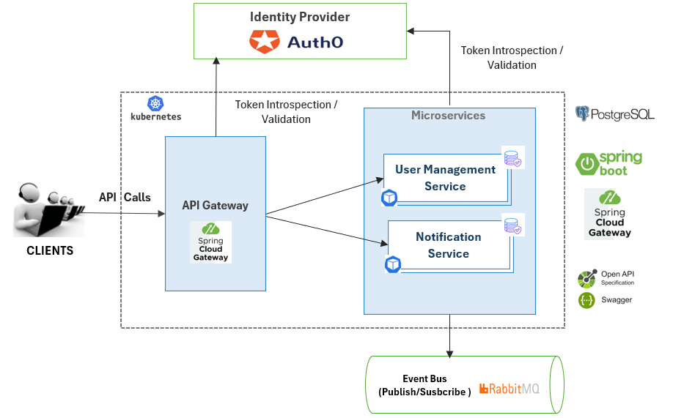
Software Architecture : High Level Design

Slide 4
Software Architecture : Convention and Package Structure
The standard naming convention for the services is “metscs673-<name>-service” and the basic package structure is:
“edu.bu.metcs673.<service_name>.api.models”: Contains the DTOs.
“edu.bu.metcs673.<service_name>.api.controllers”: Contains the controller classes.
“edu.bu.metcs673.<service_name>.api.exception.handler”: Defines the global exception handler.
“edu.bu.metcs673.<service_name>.api.configs”: Contains all configuration classes.
“edu.bu.metcs673.<service_name>.api.models.entities”: Contains the entities/JPA classes.
“edu.bu.metcs673.<service_name>.api.repositories”: Contains the data access repositories.
“edu.bu.metcs673.<service_name>.api.services”: Contains the service interfaces.
“edu.bu.metcs673.<service_name>.api.services.impl”: Contains the business logic.

Slide 5
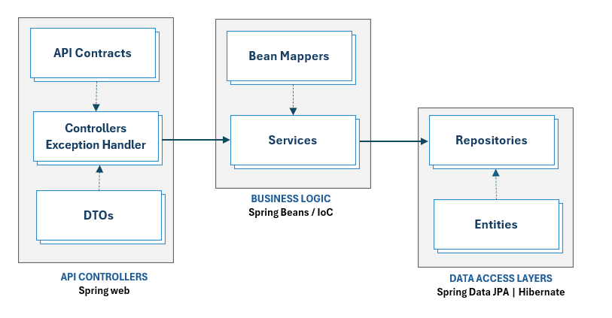
Software Architecture : Components

Slide 6
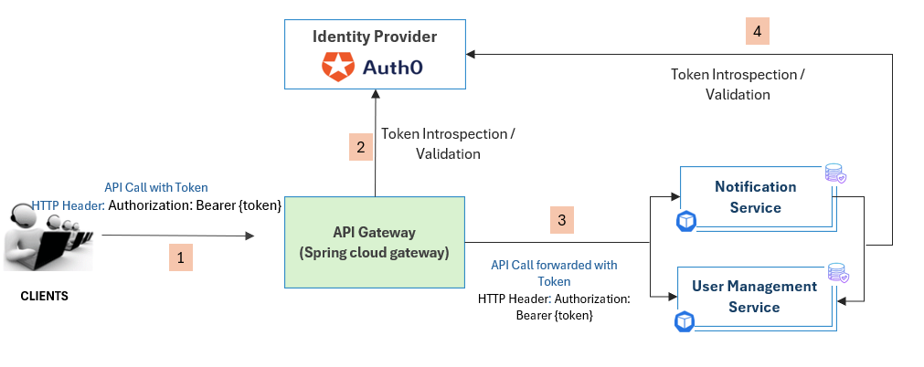
Security Design: Overview

Slide 7
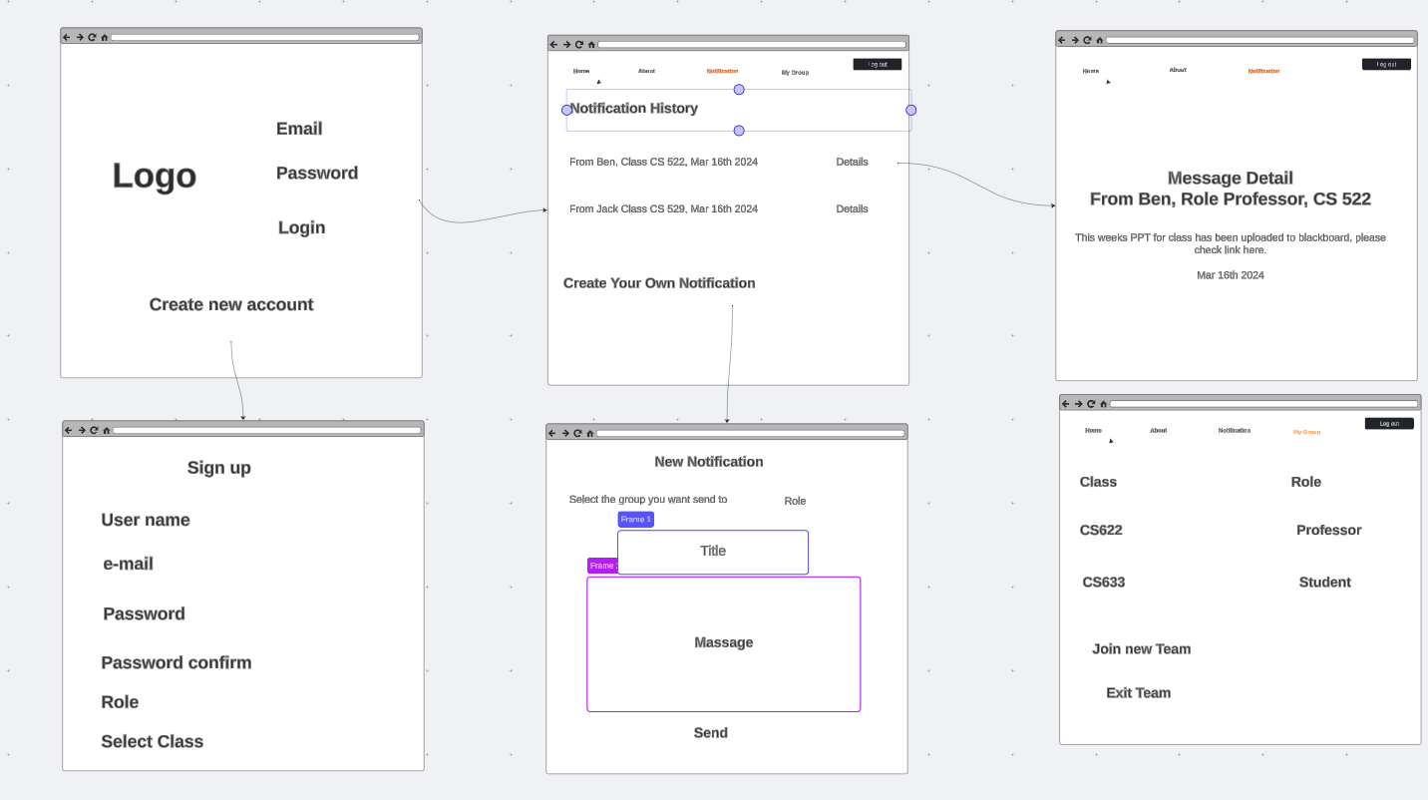
UI Draft

Slide 8
Next Steps：
Key features：
Create Group
Join Group with Permission
Send notification to group member
Leave Group
Tasks：
Database design for retrieval in PostgreSQL
Integrate permission setting with group
Implement backend logic for storing preferences in PostgreSQL
Integrate with RabbitMQ for delivering notifications through chosen channels.
Integrate group feature with notification service
Store notifications in PostgreSQL
Unit tests
Test end-to-end functionality.

